Slide 1


NATIONAL EXTENSION TECHNOLOGY CONFERENCE · JUNE 2026 · GAINESVILLE, FL
Your Website Is Now
a Training Set
Preparing Extension for the Post-Search Era
David Warren
Digital Strategist, OSU Agriculture
AI Program Manager, Extension Foundation

Slide 2
Game Code: D2T2DW

Slide 3
National Scope. Local Impact.
501(c)(3) Non-Profit · Founded 2006
Formed by Extension Directors and Administrators, the Foundation empowers a national network of community-based educators, volunteers, and partners to turn knowledge into real-world solutions for stronger communities and people.
Learn more at extension.org

Slide 4
This talk in one slide:
Search engines are morphing into AI answer machines, severing a key digital connection between Extension and its audience
Rework your sites for GEO (SEO+) so you stay visible online.
Own the relationship with the subset of audience who want more, through direct channels using CRM as a “spine”.

Slide 5
PART 1
SEARCHPOCALYPSE

Slide 6
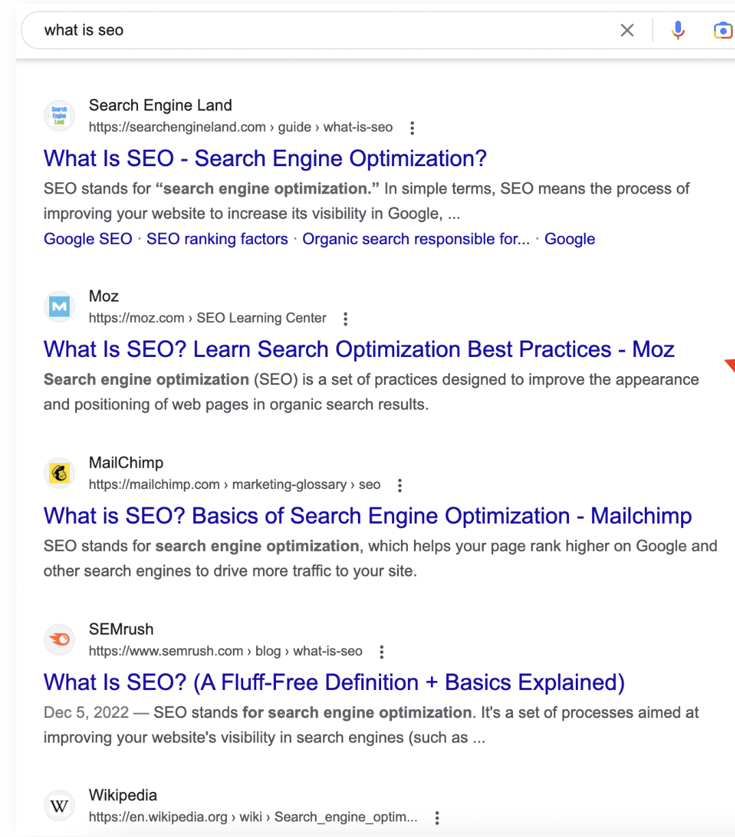
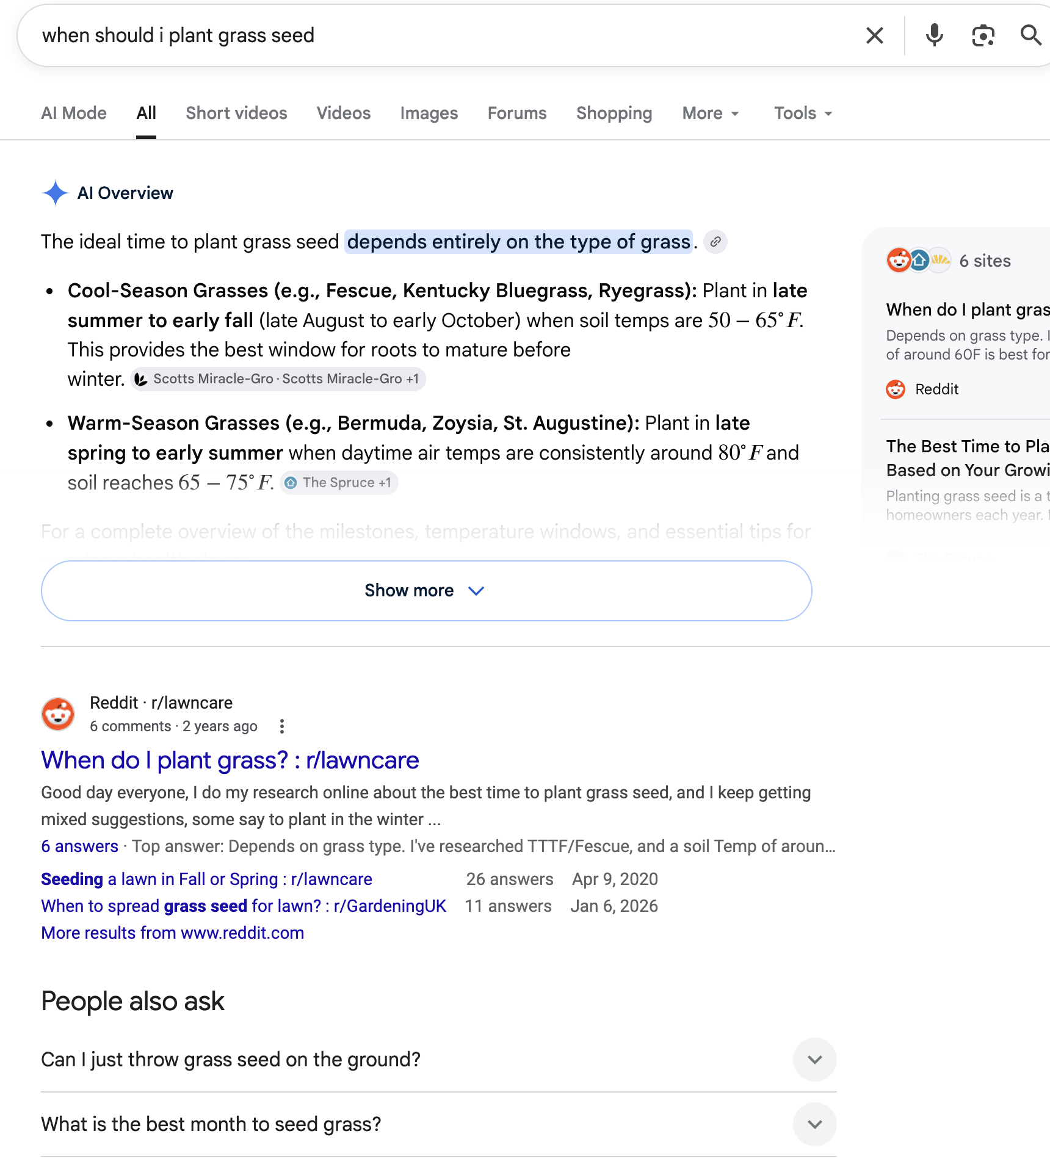
SERP with Ten Blue Links
SERP with AI Overview

Slide 7
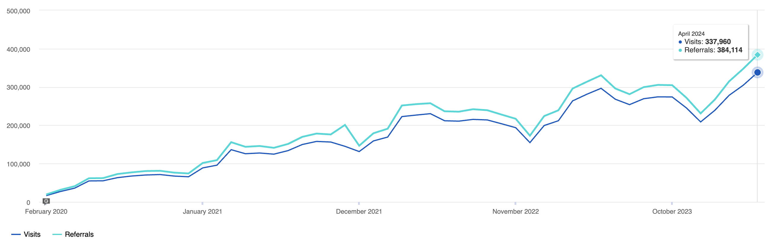
OSU Extension: 15x growth of search visits in 4 years
February 2020 – April 2024
Source: SiteImprove analytics

Slide 8
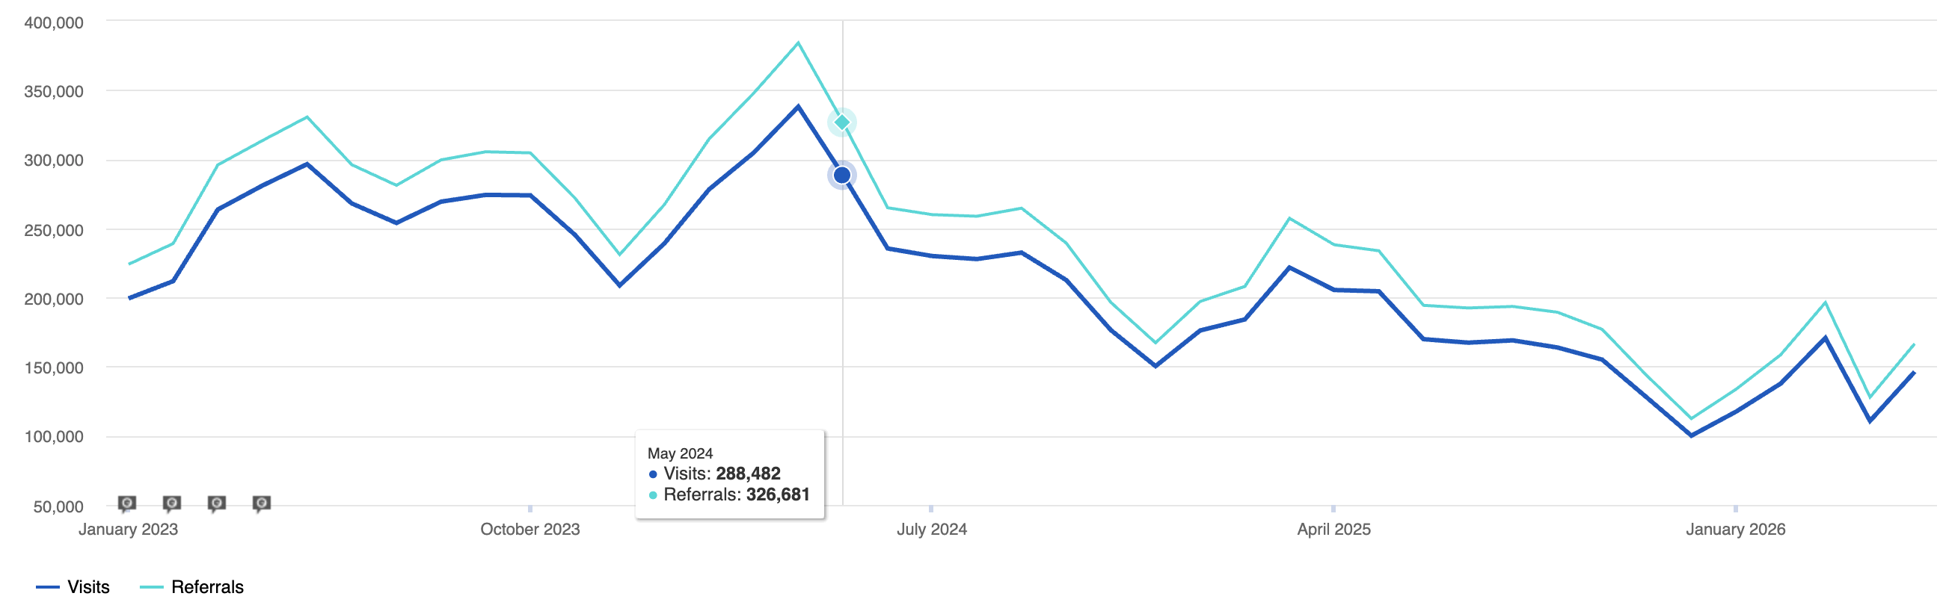
50% drop in visits from Search Engines in 24 months
Google AI Overviews
Launch
CMS Migration
Seasonally adjusted, comparing January – March 2026 to January – March 2024
Source: SiteImprove analytics

Slide 9
Search traffic decline – example informational sites (annual)
Website traffic decline, recent year over year
89%
click-through rate on searches showing an AI Overview
49%
40%
40%
33%
DMG Media
Chegg
HuffPost
Business Insider
News sites
Sources: DMG Media statement to UK Competition and Markets Authority, 2025 (Daily Mail desktop CTR, 25.23% to 2.79%, on AI Overview queries); Chegg company filings; Similarweb (HuffPost, Business Insider, 2025 YoY); Chartbeat 2,500+ news sites, 2025.

Slide 10
Zero-Click Search Growth
Percentage of global searches that ended without the user clicking on a website.
Search volume
Source: LLMrefs

Slide 11
How AI Overviews are impacting clicks
Position | Click rate, no AI Overview | Click rate with AI Overview | Change
Position 1 | 39.8% | 19.0% | 58% drop
Position 2 | 18.7% | 12.6% | 51% drop
Position 3 | 10.2% | 5.5% | 46% drop
~90%
of fact-sheet-relevant searches likely show an AI Overview.
Source: Ahrefs
Ranking on page 1 in search no longer is a guarantee of success.

Slide 12
The Old Three-Part Model
For decades, the web operated on a three-part intermediary model
1
2
3
The Creator
(Publisher)
The Intermediary
(Google)
The Consumer
Writes the article, conducts the research, or compiles the data.
Organizes the information and acts as a traffic director.
Uses Google to find the publisher, then clicks through to the publisher's site.
Creator → Intermediary → Consumer: the model AI is now disintermediating

Slide 13
THE NEW BARGAIN
The bargain between publishers and Google has changed with AI Overviews
WHAT GOOGLE GETS
WHAT THE PUBLIC GETS
~5% click-through · ~$5
Unbiased
Ad impressions on every search, plus an average $5 click roughly 5% of the time — on content from publishers like Extension.
Science-based expertise from a source without commercial bias — at least with Extension content.
Your website isn't a destination anymore. It's a training set for AI.

Slide 14
DEFINITION
Disintermediation
PUBLISHER
GOOGLE
CONSUMER
AI ANSWERS DIRECTLY
The removal of the middleman from the information supply chain — Google bypasses the publisher's site to deliver content directly to the consumer.

Slide 15
PART 2
GEO - Generative Engine Optimization (SEO+)

Slide 16
What is Generative Engine Optimization (GEO, aka AI SEO & AIO)
The evolution of Search Engine Optimization (SEO) designed specifically for AI-powered search engines and answer engines (like Google's AI Overviews, ChatGPT, Claude, and Perplexity).
Feature | Traditional SEO | Generative Engine Optimization (GEO)
The Target | Search Engine Crawlers (Googlebot, Bingbot) that index text to match keywords. | Large Language Models (LLMs) and RAG systems that parse context, logic, and entities.
The Output | A curated list of blue links and snippets pointing users to external websites. | A synthesized, single narrative answer generated by AI, featuring inline citations.
Content Priority | Keyword placement, search intent matching, and traditional link-building (backlinks). | Information density, authoritative data, expert quotes, and structured schema markup.
The User Journey | The search engine is a traffic director; the user leaves the engine to consume content. | The search engine is the final destination; the user gets the answer without clicking away.

Slide 17
What is Generative Engine Optimization
(GEO, aka AI SEO & AIO)
The evolution of SEO designed specifically for AI-powered search engines and answer engines
(like Google's AI Overviews, ChatGPT, Claude, and Perplexity).

Slide 18
Tactics to succeed in GEO and SEO
What AI systems need to cite your content - GEO | What traditional search needs to rank content -SEO
A direct answer in the first 100 words Question-framed headings (H2/H3) A Quick Facts summary block An explicit FAQ section Named, credentialed author Visible Last Updated date Machine-readable schema markup (JSON-LD) | Short, direct title (target 5–7 words) Keywords in H1, first paragraph, and URL slug Descriptive meta description (150–160 chars) HTML content (not PDF-only) Logical heading hierarchy (H1 → H2 → H3) HTML tables (not image-based tables) Internal links to related fact sheets
See David’s Word Doc: Fact Sheet Format Guide 2026 Draft

Slide 19




Extension is structurally built to do well the citation game.
Land-grant authority
Named expert authors
.edu domain
Fact-checkable claims
Institutional credibility AI engines actively weight.
Real credentials, the strongest trust signal there is.
A seed-site signal that lifts every page on the site.
Sourced statistics and references, exactly what gets cited.

Slide 20


GEO - Three things make a page citable.
Extractable
Authoritative
Present
AI pulls passages, not pages. Each section must answer one question well enough to stand on its own.
Named experts, credentials, sourced statistics, dated content.
AI cites where you already appear: Wikipedia, Reddit, YouTube, .edu directories, trade publications.
Princeton GEO study (2024)

Slide 21
PRINCETON GEO STUDY · TACTICS RANKED
What actually moves the needle for AI visibility
1
Embedding expert quotations
Attributed quotes from domain experts signal credibility.
+41%
2
Adding statistics & numerical data
Concrete numbers beat vague assertions.
+30–40%
3
Including inline citations
Clean "chain of trust" earns RAG selection.
+30–40%
4
Fluency optimization
Cleaner prose matches LLM training bias.
+15–30%
5
Authoritative voice
Definitive, direct, minimal hedging.
+10–20%
THE POWER COMBO Pairing Statistics with Fluency Optimization yields the highest compound benefit of any two-tactic pairing.
Source: https://derivatex.agency/blog/princeton-geo-paper-plain-english/
Source: https://arxiv.org/abs/2311.09735

Slide 22
PRINCETON GEO STUDY · WHAT NOT TO DO
Tactics that flopped — or hurt visibility
Keyword stuffing
Forcing exact-match keywords. LLMs parse meaning, not repetition.
−9%
✕
Easy-to-understand simplification
Stripping technical nuance removes the depth LLMs need.
Neutral
✕
Content padding
Fluff to hit a word count. LLMs prioritize information density.
Neutral
✕
Pure persuasive language
Promotional copy offers no benefit to RAG systems.
Neutral
✕
0% baseline
THE TAKEAWAY Old-school SEO “tricks” don't just stop working — they actively reduce AI visibility.

Slide 23

Before…

Slide 24
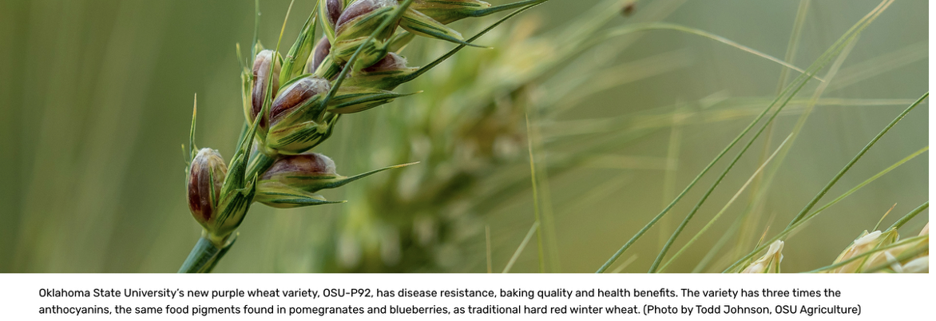
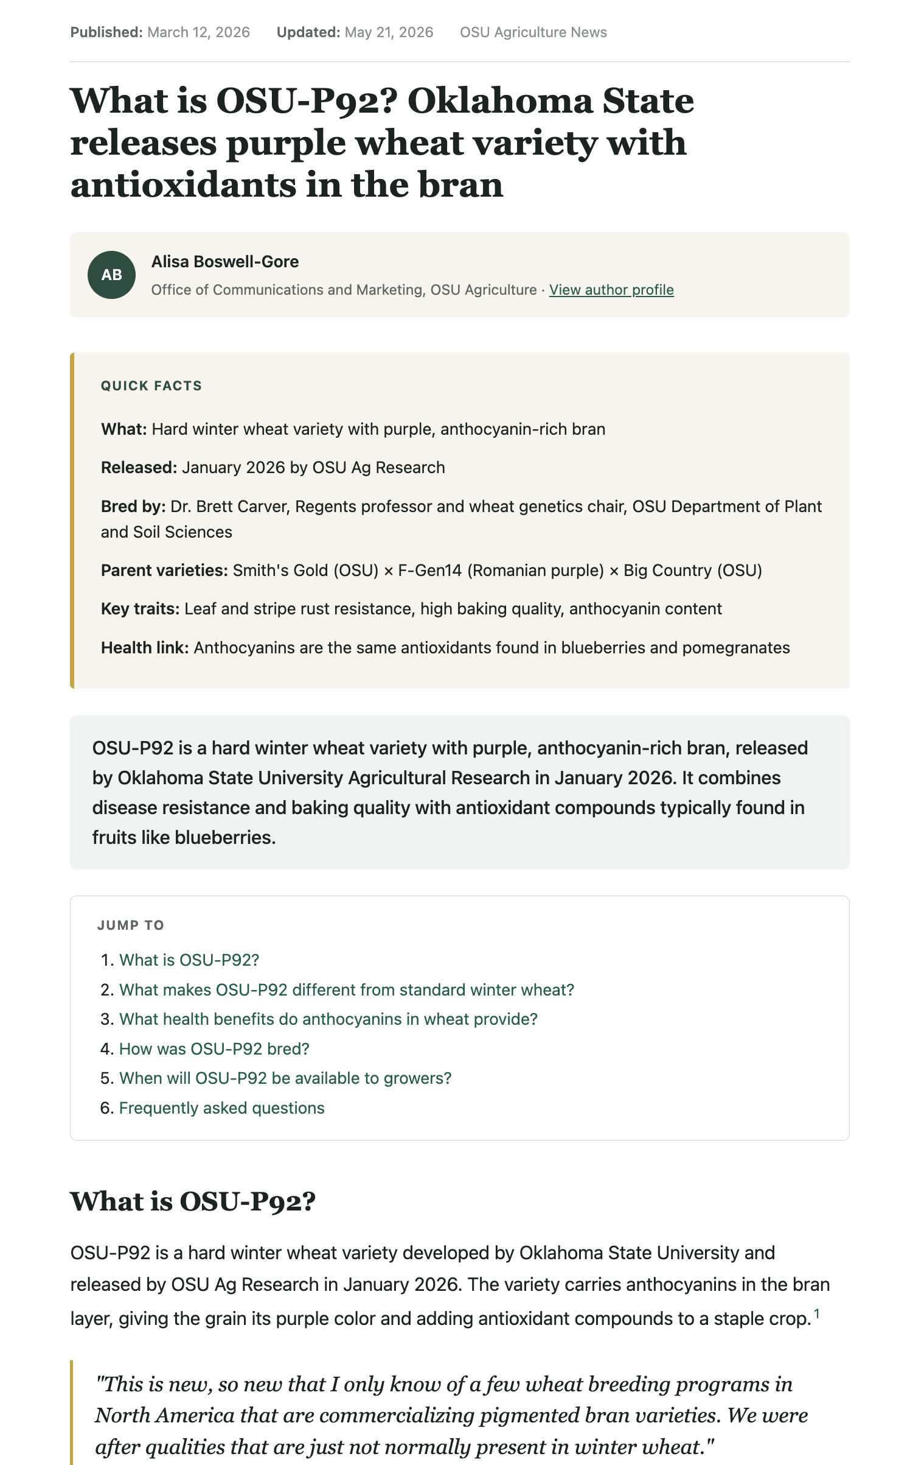
After…
(html mockup for GEO, not final)

Slide 25
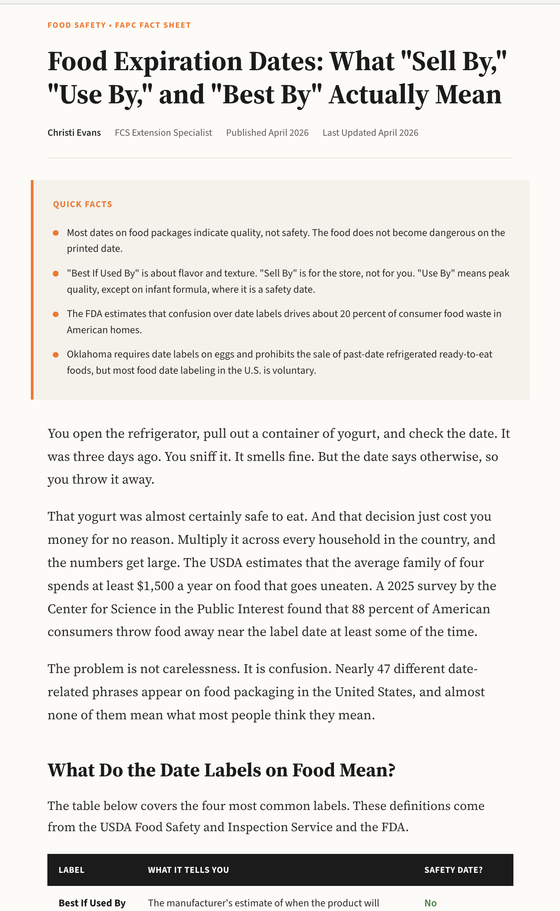
Another prototype html fact sheet, GEO optimized

Slide 26
GEO - Five writing tactics that win citations.
Lead with the answer
A direct, self-contained statement up top. A Quick Facts box AI can quote verbatim.
1
Write headings as questions
Match how people actually prompt AI, so each section is a retrievable answer.
2
Use structure AI can extract
Tables, lists, comparison blocks beat prose. Comparison content earns about a third of AI citations.
3
Show your authority
Named expert, credentials, sourced statistics, visible dates and citations.
4
Add FAQs, keep it fresh
Catch the conversational follow-ups one article can't. Stamp and revisit annually.
5

Slide 27

Make the page machine-readable: structured data (schema.org) and JSON-LD.
This is where a technology audience can go deeper than a writing team. Schema tells the AI what the page is, who wrote it, and how to cite it.
Article / NewsArticle
FAQPage
HowTo
Dataset
FAQPage · fact sheet head
What the markup earns you
{
"@context": "https://schema.org",
"@type": "FAQPage",
"mainEntity": [{
"@type": "Question",
"name": "When should I fertilize my
lawn in Oklahoma?",
"acceptedAnswer": {
"@type": "Answer",
"text": "Fertilize once soil hits 65F."
}
}]
}
A clean, labeled block the AI can lift and attribute
Author, credentials, and dates the AI reads as trust signals
Question-and-answer pairs mapped to how people prompt
Eligibility for rich results in traditional search too

Slide 28
MY TO-DO LIST
What I'm doing at OSU
GEO · OPTIMIZE FOR AI CITATION
SEO · STAY VISIBLE IN SEARCH
CONTENT STRUCTURE
ON-PAGE
Add FAQ section near bottom of fact sheets
Improve meta descriptions
Add summary/preview at the top
Enhance alt tags & image captions
Rewrite section headers as questions
ENTITY & TECHNICAL
AUTHORITY SIGNALS
Claim Google Machine IDs (MIDs) statewide
Add inline citations & footnotes
Improve mobile page speed
Feature author credentials
Update / annotate publication dates
WHY THIS LIST
STRUCTURED DATA
GEO is where new visibility is won.
SEO still matters — but most upside now comes from being citable, not just rankable.
Embed content as JSON-LD
Reference schema.org vocabulary
TOPICAL DEPTH & REACH
Build topic clusters & resource centers
Create “Best Option For…” content
Linking strategies (Reddit, Quora)
Train authors on GEO and SEO

Slide 29
Being citable is necessary. It is not sufficient.
MOVE 1
MOVE 2
Stay citable & findable
Own the relationship
Build the audience in channels you do control
Get traffic and brand mentions as feasible through the web and AI platforms..

Slide 30
PART 3
Own the relationship with direct marketing & CRM

Slide 31

Own the relationship: convert, capture, run it on a CRM.
Give people a reason to identify themselves
CRM as the spine
Tools and calculators that return a personalized result
Every touchpoint feeds one database. Consent, segments, and tags drive direct channels: email, SMS, online communities, personalization, events and the rest.
Events, webinars, and workshops with sign-ups
Downloads, quizzes, and community portals
Geo-targeted/personalized newsletters worth subscribing to

Slide 32
To do:
Be the source AI systems cite → optimize your sites for AI platforms.
Own the relationship with the people who want more → Direct marketing strategies w/CRM tools.
David Warren · davidwarren@extension.org OR david.warren10@okstate.edu

Slide 33


