Slide 1
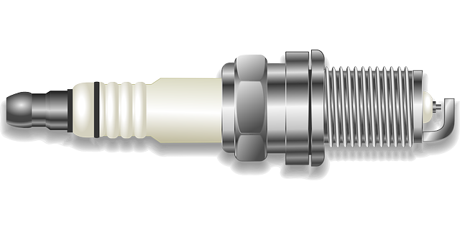
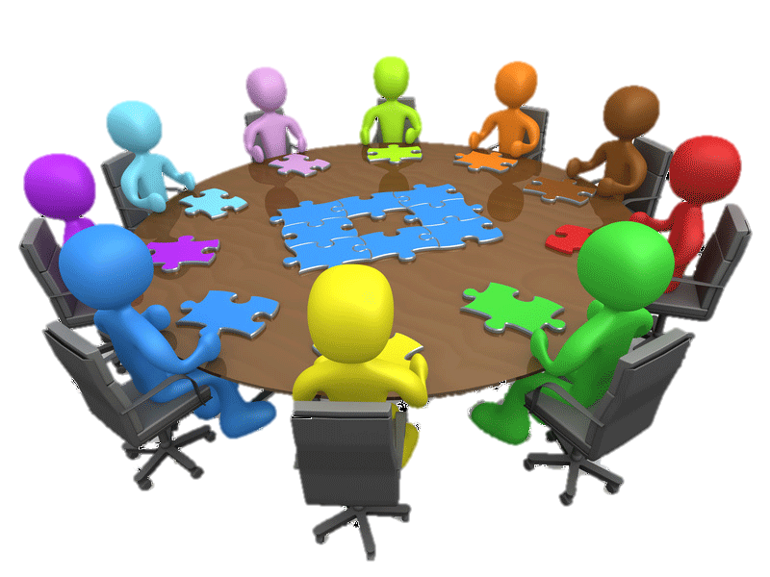
Team
List Team Members
Review Vision and Mission - Are changes needed?
Step 4 – SWOT Analysis
Step 6 – Ideation ( Ideas to Close the Gap)
Drive Higher Value for Stakeholders
More Effective Use of Resources
Strengths?
Weaknesses?
Opportunities?
Threats?
Need Ideas?
Look at the list of Spark Words..
Follow brainstorming guidelines. Suspend judgement & build on others’ ideas. Remember, the best way to have great ideas is to have lots of ideas and throw away the bad ones. Use back of chart if necessary.
Step 1 - Vision & Mission
Step 2 - Ups and Downs
Last Year’s Wins - “Ups”
In a few words, summarize the gap between the current state of your area and the desired state.
Last Year’s “Downs”
Insights from Ups and Downs? Stop, Start,
Continue, Improve?
Step 5 - Gap Analysis
Role Storming
Round 1 – Assign a role (Dreamer, Realist, Critic, Revolutionary, Gate Keeper to group members. Discuss each idea through that perspective.
Round 2 - Define your major stakeholder groups and write each of them on a card. Have each member of the team draw a card and “role storm” (discuss each idea through the perspective of that stakeholder). Are there stakeholder concerns to address?
Step 3 - Events & Trends
Step 7 - Strategic Priorities
Make sure priorities are:
Compatible with mission, vision and values
Feasible (can realistically be executed)
Desirable (meet a need/solve a problem)
Viable (value is worth the cost)
What are your “critical few” strategies? Number in priority order. Use back of chart if necessary.
Political:
Economic:
Social:
Technological:
© 2015 TriSource Associates

Slide 2
Current vs. Desired Grid
High
Low
© 2014 TriSource Associates- All Rights Reserved

Slide 3
Spark Words
Eliminate
Separate
Mechanize
Reduce
Computerize
Create
Automate
Restructure
Combine
Replicate
Standardize
Minimize
Reengineer
Expand
Enhance
Initiate
Substitute
Streamline
Alleviate
Outsource

