Slide 1
Auctions
University of Florida
February 2024

Slide 2
Auctions
Florida Rule 12A-1.066 (F.A.C.)
Auctioneers, Agents, Brokers and Factors
(1)(a) Every agent, auctioneer, broker, or other person who is engaged in any business activity of making sales of tangible personal property with the object of private or public gain…is required to register as a dealer under Chapter 212, F.S., and collect and remit any applicable tax on the total retail sales price…

Slide 3
Auctions
Auctions conducted within the State of Florida are generally subject to FL sales and use tax on the winning bid amount, including auctions of:
Animals
Equipment
Vehicles & boats
Surplus property
Other tangible personal property

Slide 4
Auctions
Tangible Personal Property (TPP) is:
“Personal property that can be seen, weighed, measured, or touched or is any way perceptible to the senses…”

Slide 5
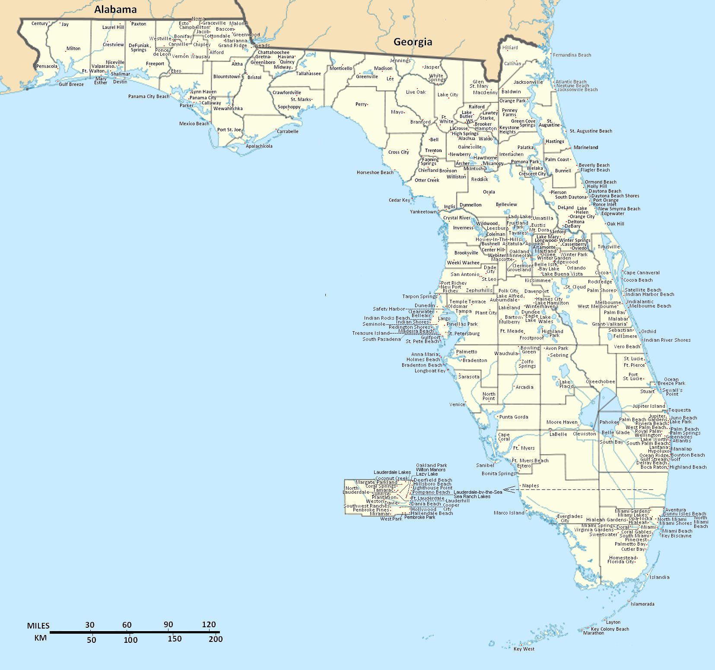
Auctions – UF Example
The UF Surplus Property department conducts online auctions of its obsolete or unneeded equipment inventory through the Public Surplus and GovDeals websites
FL sales taxes are assessed based on the type of purchaser and point of delivery or destination
The Florida county of delivery determines the corresponding county surtax that also applies

Slide 6
Auctions – Out of State
Remember: Items sold and delivered to a location outside of Florida are not subject to Florida sales tax
Keep records documenting the specific tangible personal property sold and that it was committed to export out of state

Slide 7
Auctions - Deposits
Fundraising proceeds through various events, including auctions, are typically directed to the University of Florida Foundation, Inc. as UF’s Direct Support Organization for advancement
These funds are later used within the university to support its mission of education, research, and public service

Slide 8
Auctions – Specific Exemptions
Some specific items, whether sold directly or at auction, are commonly exempted from Florida sales and use tax
Gift cards (because sales tax gets applied when the gift card is redeemed to make a purchase)
Plants for food suitable for human consumption (e.g. fruit or vegetable seeds, plants, or trees)

Slide 9
Auctions – Combined Purchase
A winning auction bid might be for a combination of items, some of which are subject to sales tax and some which are exempt
When these items are purchased together as a single sale, sales tax applies unless all of the individual items purchased are exempt from tax

Slide 10
Auctions – Certificates of Exemption
Since many auctions are often a joint effort between one or more entities (which may have a different status for sales tax exemption purposes), we generally recommend collecting and remitting sales tax on all auction proceeds
Purchasers who present a valid Florida DR-13 or DR-14 certificate of exemption may be granted an exemption from the FL sales tax
Remember that the exemption certificate does not apply to purchases paid personally (personal check, credit card, etc.)
Maintain a copy of the certificate for at least 3 years

Slide 11
Auctions – Professional Auctioneer
Has an active Florida auctioneer license
Calls and accepts bids at the auction site
Conducts the auction in a professional and ethical manner
Must prominently display his/her license and the auction business license (or provide an oral announcement at the beginning of the auction or a prominent written announcement that the licenses are available for inspection at the auction site)

Slide 12
Auctions – Professional Auctioneer
Nontaxable when the auction is conducted by a professional auctioneer who receives no compensation for conducting an auction for a religious, charitable, educational, or civic organization as a fundraising event (Rule 12A-1.037, F.A.C.)

Slide 13
Auctions – Nonprofits Benefiting Minors
Nonprofit corporations whose primary purpose is to provide activities contributing to the development of good character or good sportsmanship, or the educational or cultural development of minors, may sell [or auction] donated property tax exempt
For this treatment, donated property is any property transferred to the organization for less than 50% of its fair market value

Slide 14
Auctions – Nonprofits Benefiting Minors
To qualify, the nonprofit corporation must hold a specific Florida Consumer’s Certificate of Exemption (DR-14) showing as an organization benefiting minors [not simply a 501(c)(3) status]
UF direct support organizations do not commonly hold this status

Slide 15
Auctions – Recap
In Summary…
Auctions are not frequently conducted by UF departments
Auction proceeds are generally subject to Florida sales tax
Fundraising proceeds are usually deposited with the University of Florida Foundation, Inc.
Using an unpaid professional auctioneer may qualify the auction to be exempt from FL sales tax

Slide 16
Auctions – Q&A
Questions?
fa-sales-tax@ad.ufl.edu
(352)294-7264

Slide 17
Sales and Use Tax on the Rental, Lease, or License to Use Commercial Real Property: An Overview
University of Florida
February 2024

Slide 18
Sales and Use Tax
Sales tax in Florida is a tax on the right to engage in a business activity.
Florida sales and use tax applies to a sale, admission, rental/lease/license to use goods, certain services, commercial real property, and living/sleeping accommodations within Florida.

Slide 19
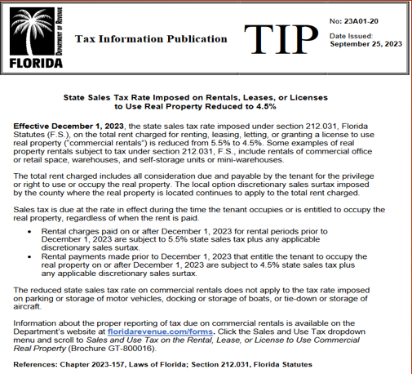
Florida Tax Information Publication (TIP) #23A01-20

Slide 20
Sales and Use Tax on the Rental, Lease, or License to Use Commercial Real Property
Sales tax is due at the rate in effect during the time the tenant occupies, or is entitled to occupy, the real property regardless of when the rent is paid. These rental charges are subject to a 4.5% state sales tax (effective December 1, 2023), plus any applicable county discretionary sales surtax.
This tax rate is applicable to all payments of rent attributable to the period beginning on or after December 1, 2023

Slide 21
Examples of taxable commercial real property rentals. Section 212.031, Florida Satutes:
Commercial office or retail space
Conference, convention, and meeting rooms
Warehouses or mini-warehouses
Self-storage units

Slide 22
Commercial Rentals
Rental/lease/right to use commercial real property
Sales tax is due on the total rent charged, which includes all consideration due and payable for the privilege or right to use or occupy the real property.

Slide 23
Commercial Rentals
BOOTH RENTALS?
Renting space to a vendor for a fee is considered the rental of commercial real property
They are renting the space (area) to either set up or use a booth

Slide 24
County Surtax

Slide 25
County Discretionary Sales Surtax
Most Florida counties have a discretionary sales surtax (county tax) which applies to transactions that are also subject to sales tax.
The county surtax rate applies to a taxable item or service sold in or delivered into any Florida county that imposes a surtax.
The Florida Department of Revenue updates the Discretionary Sales Surtax Information (Form DR-15DSS) annually.

Slide 26
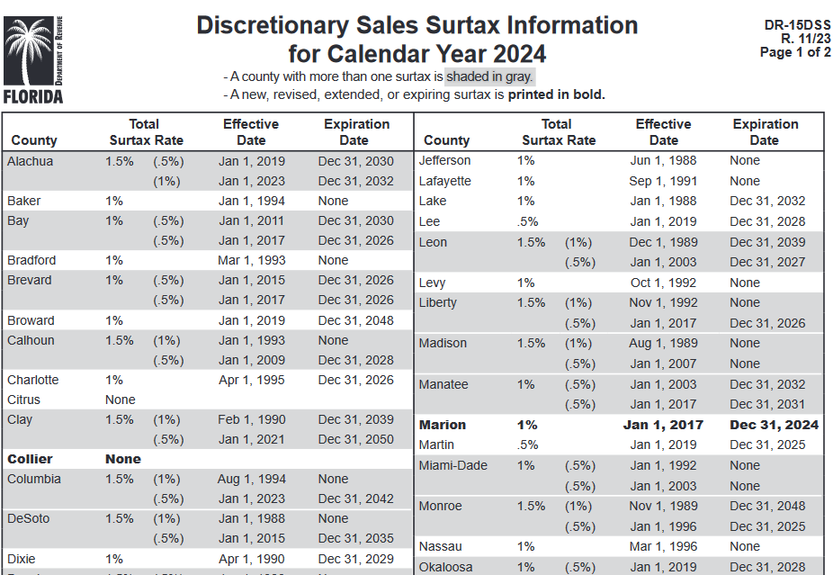
County Discretionary Sales Surtax

Slide 27
Sleeping Accommodations
Rental/lease of living or sleeping accommodations for a period of six months or less are taxable at 6.0% + county surtax
These rentals are not commercial rentals subject to the lower tax rate.

Slide 28
UF Sales Tax Reference Guide

Slide 29
Operating Mechanisms
Fee-for-Service Educational Activity units are responsible for reporting and paying sales and use taxes on sales with external customers. Departments should submit their Sales and Use tax reports to the Auxiliary Accounting Office no later than the 10th of every month via email to:
ga-aux@ad.ufl.edu
Auxiliary Accounting compiles monthly and remits a single consolidated tax return to the Florida Department of Revenue that includes all UF departments.

Slide 30
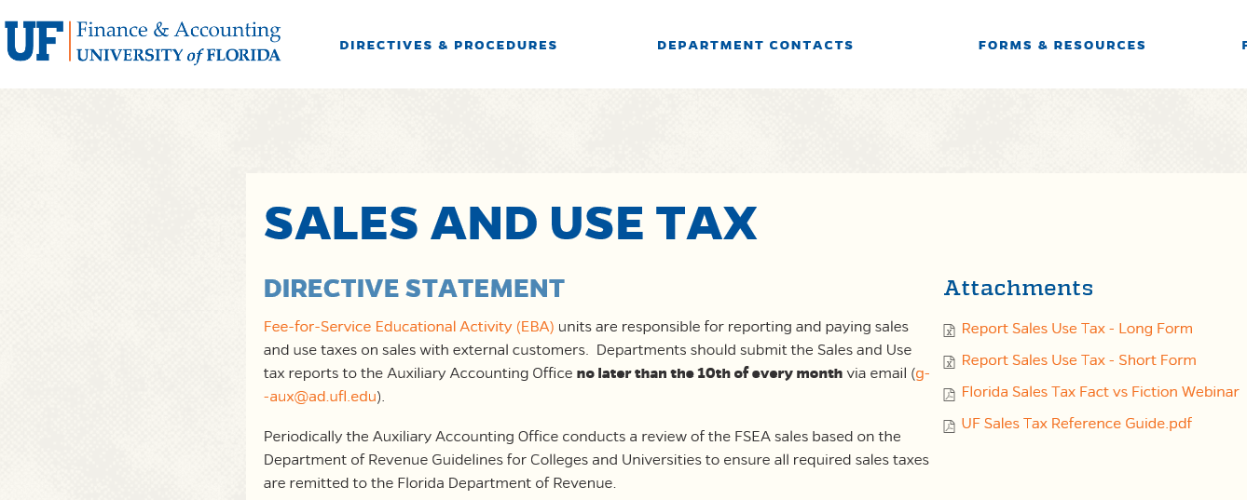
UF Sales Tax Reference Guide
A quick summary of sales tax with examples of taxable and non-taxable transactions
https://www.fa.ufl.edu/directives/sales-and-use-tax-2/

Slide 31
Sales Tax Exemption

Slide 32
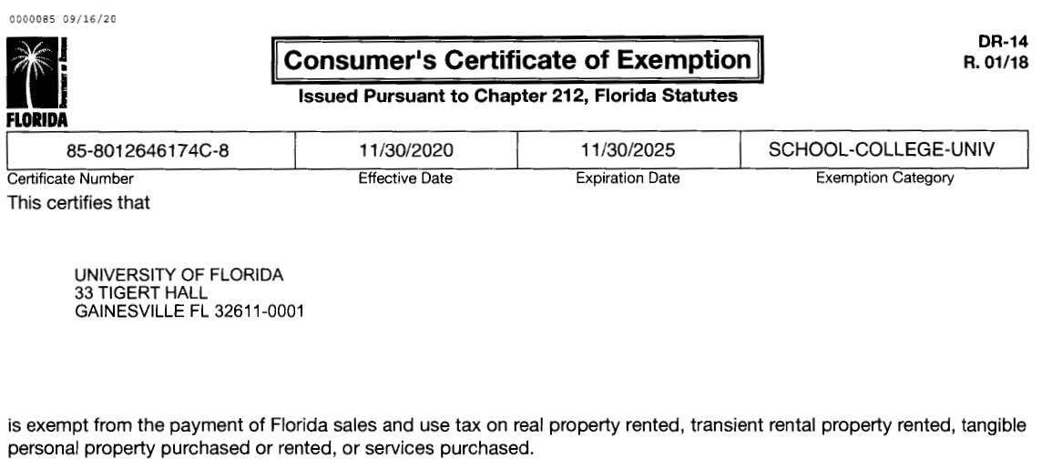
Sales Tax Exemption
Florida law (s. 212.031, F.S.) provides several tax exemptions for certain types or uses of real property.
The lease or rental of real property to nonprofit organizations that hold a current Florida Consumer’s Certificate of Exemption (Form DR-14) or to governmental entities is exempt.

Slide 33
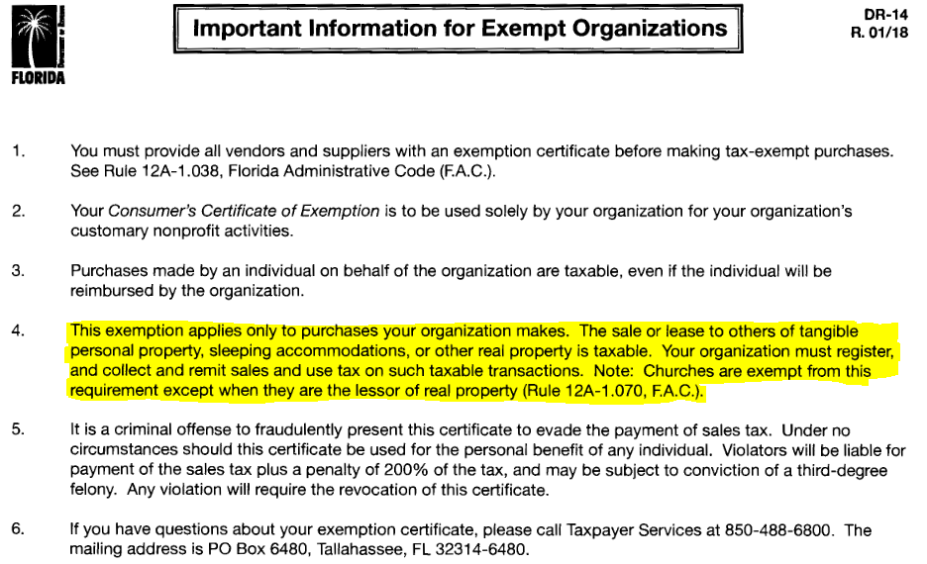
Sales Tax Exemption

Slide 34
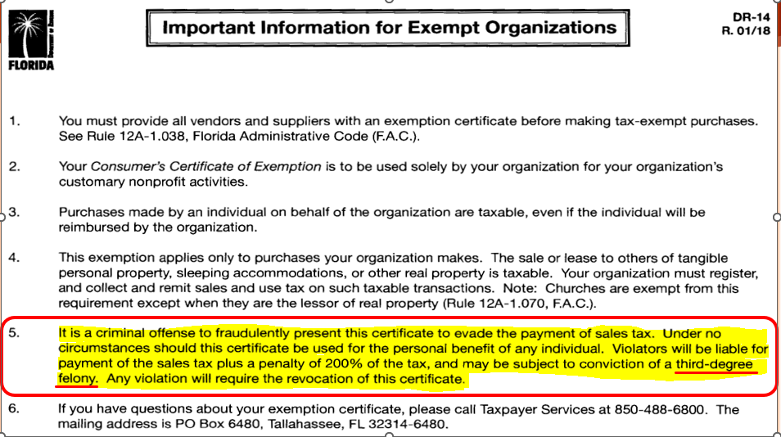
Sales Tax Exemption

Slide 35
Recent Questions
Are community garden plot rentals the same as booth rentals, and are they taxable?
Yes, rental of real property (a garden plot) is subject to sales tax as a rental of commercial real property, similar to a vendor booth rental (unless the purchaser is exempt and provides a DR-14 or DR-13 certificate.)
What are the consequences of non-compliance with Florida sales tax regulations?
Non-compliance with Florida sales tax regulations can result in penalties, interest charges, and potential legal action by the Florida Department of Revenue. It is essential for property owners to understand and fulfill their tax obligations to avoid these consequences.

Slide 36
Sales Tax Resources
UF Sales and Use Tax Website
http://www.fa.ufl.edu/departments/auxiliary-and-service-center/tax-resources-for-departments/sales-and-use-tax/
Florida Department of Revenue (FLDOR)
http://floridarevenue.com/pages/default.aspx
FLDOR Sales Tax Forms (DR-) and Guidance (GT-) http://floridarevenue.com/Pages/forms_index.aspx
Florida Statutes (Chapter 212 Tax on Sales, Use, and Other Transactions)
http://www.leg.state.fl.us/Statutes/index.cfm?App_mode=Display_Statute&URL=0200-0299/0212/0212ContentsIndex.html&StatuteYear=2021&Title=%2D%3E2021%2D%3EChapter%20212

Slide 37
Thank You!

Slide 38
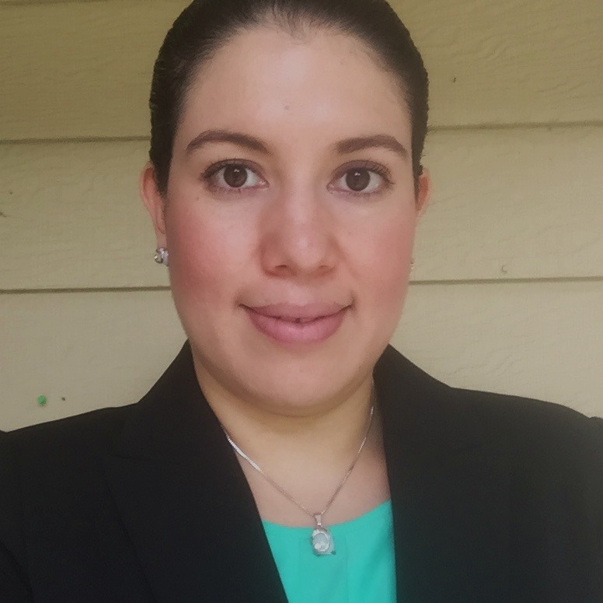
Contact us
Farley Leiriao
BRIAN KUHL
ALEXANDER HERNANDEZ
Auxiliary Assistant Controller
Tax Director
Accountant III
Sign up for the ListServ:
UF-AUX-CONTACTS-L
Phone: (352)294-7264
E-mail: fa-sales-tax@ad.ufl.edu
DORIS FLORES
Accountant III

