Slide 1
Shared Purpose
Florida Extension Business Professionals Conference

Slide 2
Our Session’s Focus
Understanding Team Development
Realizing the Power of Purpose
Detecting our Team’s Purpose
Q&A

Slide 3
A Comparison
Groups
Teams
Independent
Focused on personal objectives
“Hired-hands”
Distrustful
Don’t know how to deal with conflict
Interdependent
Aligned with team’s objectives
Take ownership
Openly communicate
Recognize conflict is normal

Slide 4
Building Blocks
People Skills
Process
Position
Purpose

Slide 5
Stages of Team Development
Forming
Storming
Norming
Performing
Notes:
*note: When new people are added to a team or new goals, problems, etc., are identified, teams often will move between these stages. It’s important to understand this informal process just as much as it is to understand the more formal processes because these informal stages absolutely affect the team’s success. By understanding and recognizing these stages as normal, you will be a more successful team leader and facilitator because you can help the team move through these stages more quickly.
During forming stage, leaders can help team move through this stage by:
Helping the team clarify the job to be done
Develop guidelines for how the team will operate and proceed with the work to be done (discussion guidelines, meeting formats, how decisions are made, role clarification and assignments). This helps clarify the team members’ expectations of one another.
Provide opportunities for building good relationships with the team (structured activities to build familiarity and interdependence)
During storming stage, leaders can help team move through this stage by:
Recognize the signs of storming and help the team manage conflict productively
Openly and honestly accept the existence of conflict as a natural part of teaming – this shows the team that this stage is normal.
Train team members in conflict management techniques
Help the group problem solve its own differences
These strategies help facilitate the process of the team so it can mature and take responsibility for its own issues.
During norming stage, leaders can help team move through this stage by:
Facilitate the resolution of conflicts
Assist the team in agreeing on the actual norms guiding the team’s work (v. the assumed ones you wrote down during the forming stage)
Recognize training needs
Acquire needed resources to meet needs
The team will develop regular ways of operating so that typical procedural problems are handled routinely. The team, at this stage, understands how it does business, including goal setting, action planning, priority setting, problem solving, decision making, and conflict management. Once these norms of how to operate are settled, the team can go into high performance mode.
During performing stage, the leader’s role is to:
Monitor progress
Manage the boundary between the team and the key external groups or individuals
Coach when unique problems arise
Create opportunities that satisfy developmental needs (additional training)

Slide 6
TEAM Purpose

Slide 7
What is it?
Goes beyond individual tasks and roles
Your unit’s essential reason for existence

Slide 8
“No organization will be as effective as it might be until its people understand and support the organization’s strategic purpose.
A muddled sense of purpose leads to confusion and allows people to decide individually what’s important, without any context to guide them.
A clear and galvanizing purpose, on the other hand, focuses everyone’s efforts and moves the organization forward in an unambiguous direction.”
Campbell and Liteman, Retreats That Work

Slide 9
Benefits
Alignment and direction
Motivation and engagement
Unity and collaboration
Resilience in challenges
Enhanced decision making
Employee satisfaction and retention
Improved communication
Innovation and creativity
Customer focus
Adaptability to change

Slide 10
Process of Development
Detecting Your Team’s Purpose

Slide 11
Questions to Consider
What do we do?
For whom do we do it?
Why does it matter?
What inspires us about the work we do?

Slide 12
Let’s Try it Out – An Activity
Working first individually, answer the following questions about your team
What do we do?
For whom do we do it?
Why does this matter?
What inspires us about the work we do?
Share your responses with a partner

Slide 13
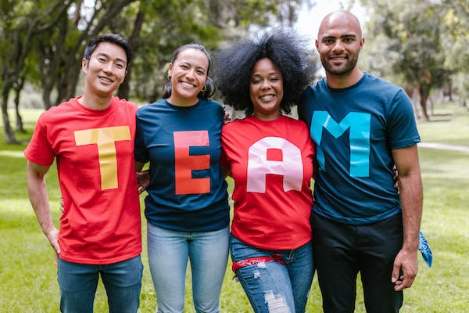
Purpose is good. Shared purpose is better.

Slide 14
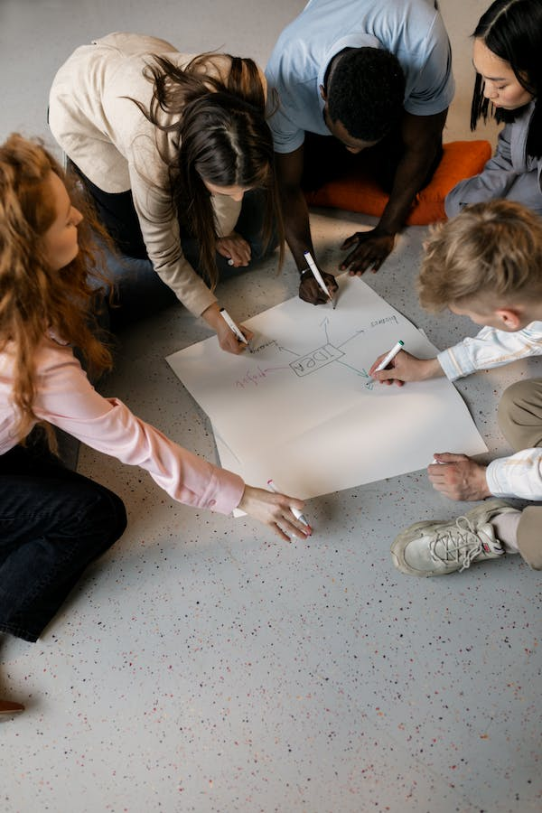
Next Steps
Discuss the “purpose questions” as a team
Create a statement

Slide 15
Reinforcing Structures
Consider alignments with work
Check-in annually
Use during onboarding
Build on purpose

Slide 16
Some Cautions
Wordsmithing
Overcomplicated or too long
Uninspiring
Lives only on a website

Slide 18
Recap
Understanding Team Development
Realizing the Power of Purpose
Detecting our Team’s Purpose

Slide 19
Courtney Moon
Courtney.moon@ufl.edu

