Slide 1
Reconciliations
Karrie Patrick
Accounting Manager, Fiscal Team Lead
Notes:
Hi, I’m Karrie Patrick, Accounting Manager and Fiscal Team Lead for IFAS Extension Business Services.
I’ll be presenting on Fiscal matters from the purchase side all the way to the assets with a focus on the reconciliation process.
Although I’m the one speaking, I’m speaking on behalf of UF, IFAS, Extension, our office as a team, and specifically on behalf of the whole Fiscal Team that would love to have the microphone & be able to shout this information from the rooftop ☺.
Before we start, we would like to remind you...

Slide 2
You are the Bridge
Notes:
You are the solid bridge of communication between Ext Bus Services and your Extension offices. Not a suspension bridge hanging by a thin wire; although, we may feel as so on some days. Instead, we are providing many tools to help you be successful and are here to support your efforts.
Extension is a very complex organization and doing some great things across the state!
Please take the opportunity to go back and share what you’ve learned this week. We do not always have the opportunity to speak with your county faculty, staff, or volunteers in the way you do. Ask your CED if you can either share what you’ve learned with him/her or better yet, ask to share in the next faculty/staff meeting.

Slide 3
Review Reconciliations 2023
Notes:
Last year we had more of a focus on how to actually reconcile an account. We’re going to take a moment to review some of the highlights from last year’s reconciliation presentation since we have quite a few new folks and then move on to a few new topics that we believe may be helpful in your role.
If you are new or new to our spreadsheets and feel you need a more basic training of reconciliations, feel free to reach out to our office. We have trained multiple offices this past year and can slow it down a bit and go over details or specific needs to your office.

Slide 4
Compare Financial Records
Monthly
Adjustments
Balance
Notes:
Essentially reconciling is comparing two different financial records to ensure they match. The best business practice is to reconcile on a monthly basis to make adjustments as soon as possible.
You should expect to see differences between the two records. Do not stress about the differences because the job of reconciling is to find out those differences and make needed adjustments.
What financial records should you be comparing? The transactions that you, your CED, faculty, or volunteers are making AND UF’s Department Reports.
Yes, the end game is to balance between the two financial records, but ensuring the transactions are accurate, allowable, and complete are key factors, as well.

Slide 5
Mistakes
Discrepancies
Fraud
Proactive
Provide Guidance
Potentially Impact Growth
Notes:
Reconciling can help detect mistakes, discrepancies, or potentially fraud. It aides in the success of Extension programs by being proactive, providing guidance, and potentially impacting growth.

Slide 6
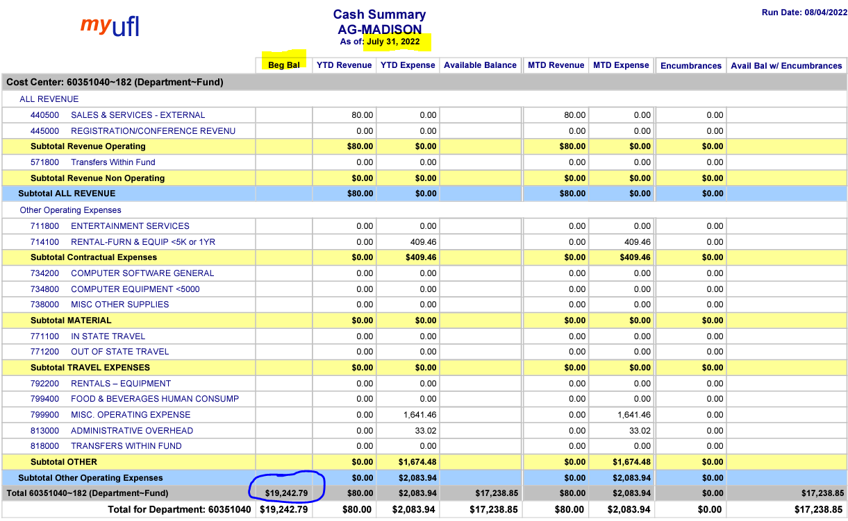
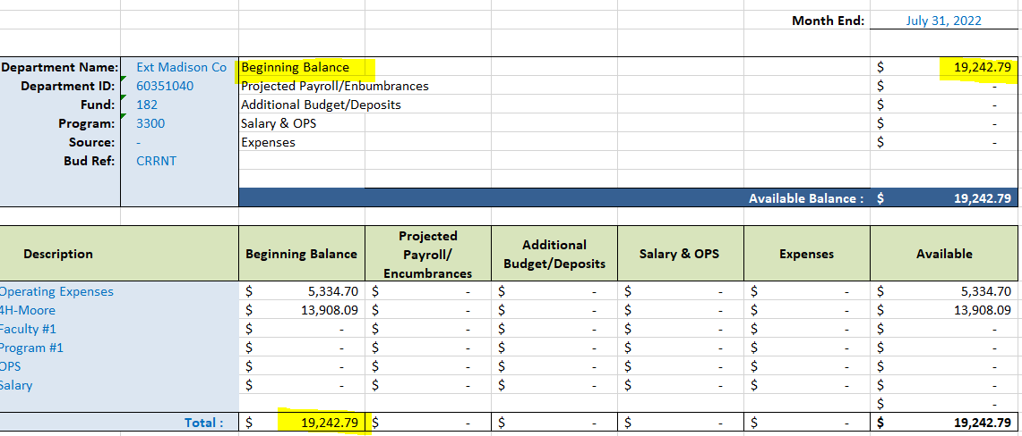
Reconciliation Spreadsheet
Department Report
Notes:
A couple of data points that you should be comparing is the Department Reports and your Reconciliation spreadsheets.
The Department Reports are kind of like the bank statements.
In this example, Once the beginning balance for July totals up to the Beginning Balance on the July Department Reports, we are ready to move forward.

Slide 7
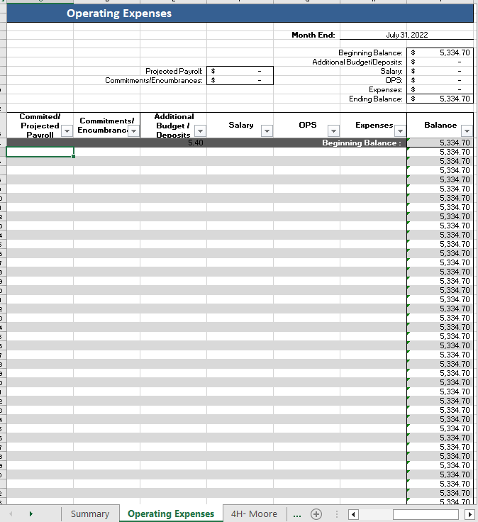
July
Clear out transaction details
Notes:
Ensure the transaction details are cleared out from previous year(s). The transactions are only cleared out at the beginning of the Fiscal Year and then the transactions roll over month to month. So, each July you will start with a clean slate.

Slide 8
Encumbrance
An Encumbrance holds the funds, making them unavailable to spend. Examples:
Purchase Orders
Travel Requests
Notes:
On a typical month, there may be encumbrances. What exactly is an encumbrance? A hold for that expense, making the funds unavailable to spend on something else.
A few examples of when a transaction may be encumbered: Purchase Order or Travel Requests.
If you have a transaction over your PCard limit, the best business practice is to have the person/company paid via an invoice. One major reason is to encumber the funds. Yes, you can request a one-time PCard limit increase; however, even that request should be limited to when an invoice cannot be obtained or the person/individual only accepts credit cards.

Slide 9
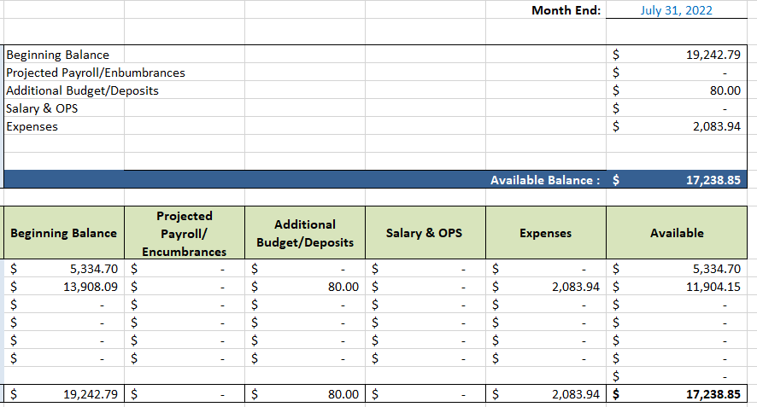
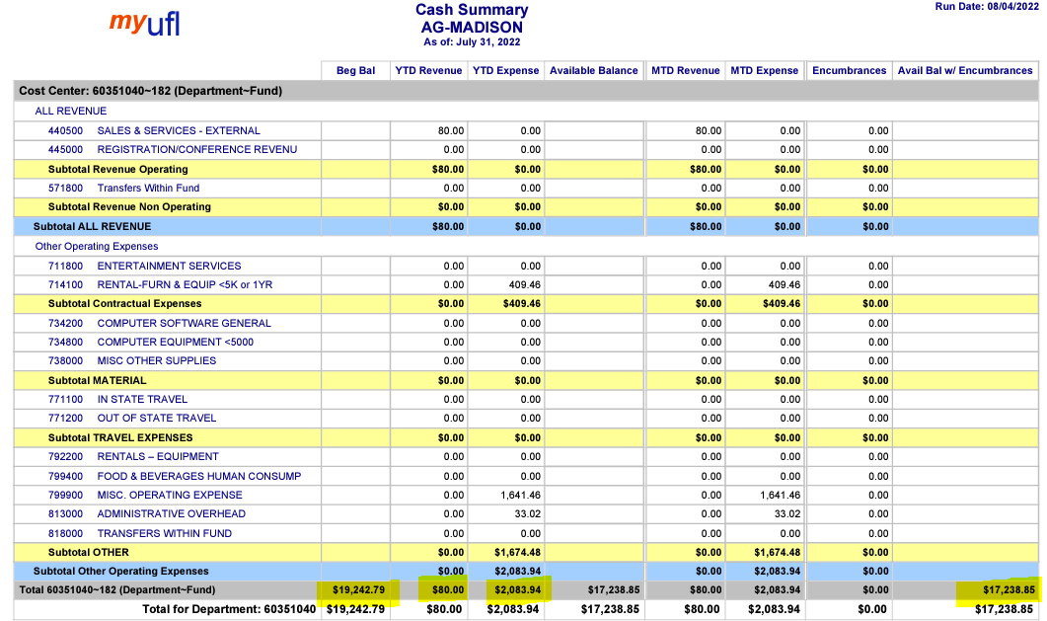
Notes:
When reconciling, you should Compare the summary of the Reconciliation spreadsheet and the Cash Summary report, we see that each section matches up… Beginning Balance, Deposits, & Expenses. After each section matches up, we have balanced the account.

Slide 10
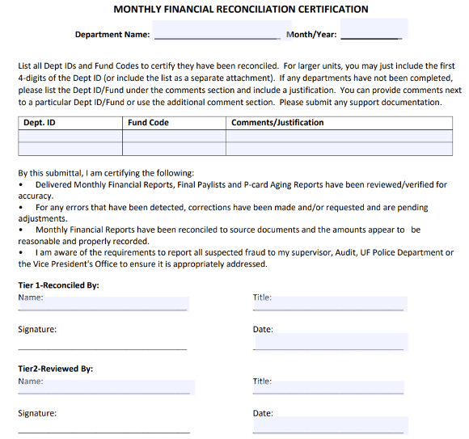
Upload to Sharepoint
SharePoint Website:
https://uflorida.sharepoint.com/sites/ifas-extadmin/external/SitePages/Home.aspx
Navigate to
District > cash folder > FY > upload > file
Naming scheme:
Year-Month-Dept ID-Fund-Prog-Period
2023-01-6035XXXX-182-3300-CRRNT
Needs Fiscal Staff & CED signature
Notes:
Once you have fully reconciled, sign the certification form, have your CED review and sign, upload your full reconciliation spreadsheet to SharePoint, & complete the notifications form to let us know it has been uploaded.

Slide 11
RCM Fee 1.61% Overheads Fee 10%
Notes:
Starting 7/1/2023, the fee for 182 funds changed from 1.61% to 10%. It used to be called an RCM fee, it is now called an Overheads Fee. The fee is taken out of all expenses. There will be several Journal Entries hit the Department Reports in January & February while we catch up to where we need to be.
Fees
103-funds 0%
182-funds 1.61% > 10% on Exp
143-funds 2.75% CC (previous month), 10% RCM 10% Admin Exp on Rev
171-funds 3% CC, 5% Foundation Dep

Slide 12
Overheads Fee
 | April Dept Report | May Dept Report | June Dept Report | July Dept Report
10% of March Expenses | 24.37
10% of April Expenses |  | 16.42
10% of May Expenses |  |  | 9.67
10% of June Expenses |  |  |  | 33.12
Notes:
Eventually you’ll see the 10% fee for the previous month hit the Department Report cleanly. Here’s a few examples. The 10% fee for March Expenses will land on the April Dept Report. The 10% fee for April will hit the May Dept Report & so forth.

Slide 13
Transaction Details
Notes:
The Department Reports, specifically the summary, encumbrance, & transaction details are necessary in reconciling accounts.
When purchasing, paying an invoice, or using a Chartfield, we ask that you enter/provide the UFID of the person the expense is for.
The UFID is helpful information when reconciling.
Within the Transaction Details, you’ll see the UFID of the person the expense is for, a short description, and even be able to click on the link to the Onbase documents that were attached.
Occasionally, you will have Journal Entries, salary, or other transactions that may not have backup documents. If you need assistance determining what a transaction is related to, feel free to reach out to our office.
If you feel you are lacking documents in UFGO transactions on your county 182 accounts, please work with your CED, faculty, & volunteers to ensure they are uploading supporting documents.

Slide 14
Transaction Basics
99% of the time we need to know what Chartfield will be used.
Documents
Detailed Receipts
Business Purpose
Allowable
Pass the sniff test?
Educational Purpose
Basic needs that assist with job duties.
Shop in marketplace
Full Chartfield
Not Allowable
Agenda/Itinerary
List of Attendees
Financial Approval Email
Align with UF/IFAS Extension’s mission?
Program area/scope of job duties?
Personal in Nature
Unsafe
Do not merely restate the purchase
No clear business purpose
Gifts
1
2
3
4
5
Notes:
Here is some data we should be checking into when making a purchase or reconciling accounts.

Slide 15
UFGO- Hot Topics
Allowable Use of Funds
Booking Tool
Expense Types
If using funds outside of the users typical budget, include email approval from the fund administrator on those funds.
Booking Tool is required.
Book with the World Travel System (# is on front page of Concur)
Exceptions:
Airbnb (Cost Comparison needed)
20% Savings (Cost Comparison needed)
Blocked Room Rate (Comment needed)
Make sure the Expense Type aligns with the purchase
UFGO TEAMS channel has a link to Expense Types
If you’re not on that channel, ask your CED or our office to add you.
Notes:
The UFGO experts will speaking next, so we don't want to spend too much time in this are; however, we do want to touch on a few topics that we feel may be helpful.

Slide 16
PCard Only
Travel
General Reimbursement
Not travel related
Or
No overnight stay
Overnight stay
Travel Request
Travel Expense Report
Try to alleviate
Fuel for daily use
Conference/meeting over multiple days. Lodging, fuel, meals
CC machine was out of commission & only payment method was cash

Slide 17
Marketplace
Business Purpose
Carts Processed Daily
Please provide a detailed business purpose, do not just restate the item.
We process carts on a daily basis.
Shop in Marketplace
Assignment of Carts
UF requires for us to shop in Marketplace prior to shopping from outside companies.
Shopping with outside companies solely based off of convenience is not a valid justification.
If you have to purchase outside of marketplace, please add a justification in the comments section of UFGO or when submitting the invoice for payment.
Michelle LeGrande- County 182, 143, 171 Funds (Example: 6035XXXX-182-3300-CRRNT)
Karrie Patrick or Andreas “Dre” Gross- Dean Funds (Examples: EPAF, FSSP, IST, Awards (non-grant)
Christy Huntley or Brittany Milito- Grant 2XX Funds (Example: 6035XXXX-209-2200-G000430-P0326096)

Slide 18
Search Purchase Orders (PO)
Notes:
Oftentimes carts do not have documents attached on the Transaction Details page, when reconciling. If you see a PO # on the Transaction Detail report and you are not aware of the order, search the # directly in marketplace from the top right search box

Slide 19
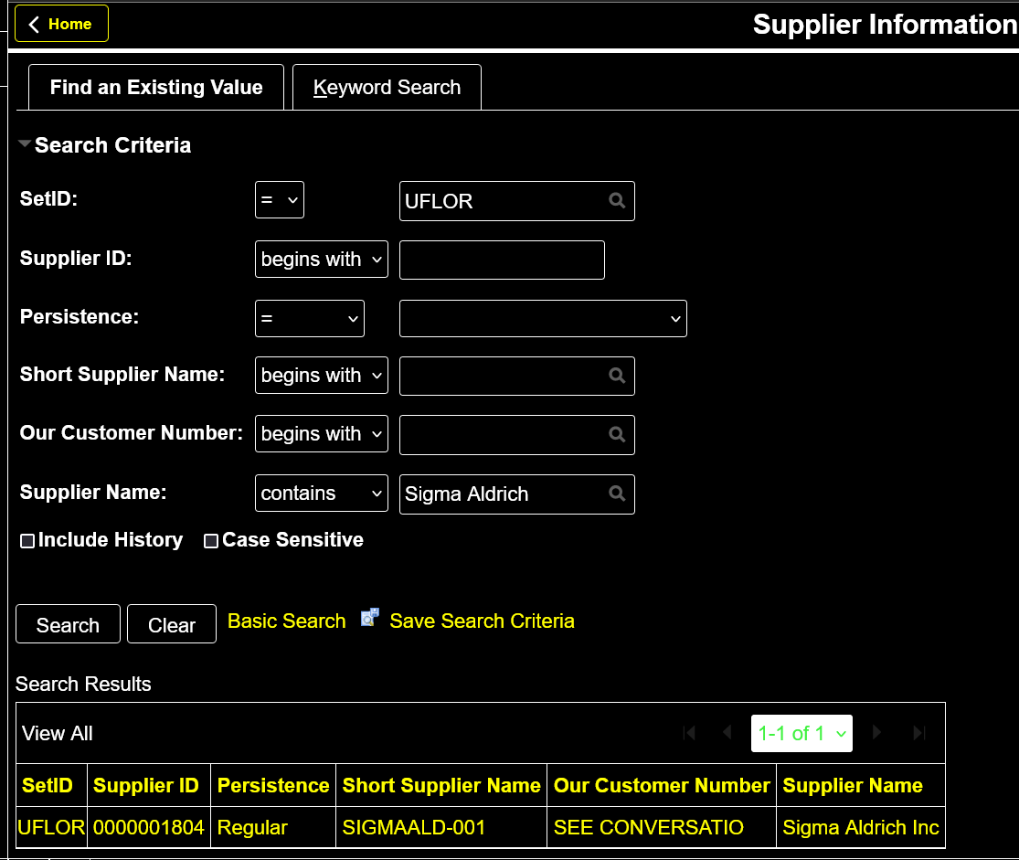
UF Supplier? my.ufl.edu > Main Menu > Financials > Suppliers > Supplier Information > Add/Update > Supplier
Click “Contains” within the drop down of the Supplier Name, enter the supplier name, & click search.
Notes:
Curious how to look up a Supplier?... There are a few ways we can tell if a company is a UF Supplier. Here is one way…
Having issues finding the supplier, try adding a % sign in the place of a space. Sometimes it will search for the name directly; other times the % sign is necessary.

Slide 20
Assets
Ensure the decal is placed on the proper asset.
Item received
Over $300.00
Contact our office
Make, Model, Serial #, Main User’s name, Picture (if unique). Information of any item being replaced. If recycled, we will need name of recycling program/place.
Asset added/removed
We will add/remove assets on UF/IFAS Extension’s inventory
UF Decal
UF Decal will be mailed out
Decal Placement
Notes:
Assets are part of our responsibility in the financial world.

Slide 21
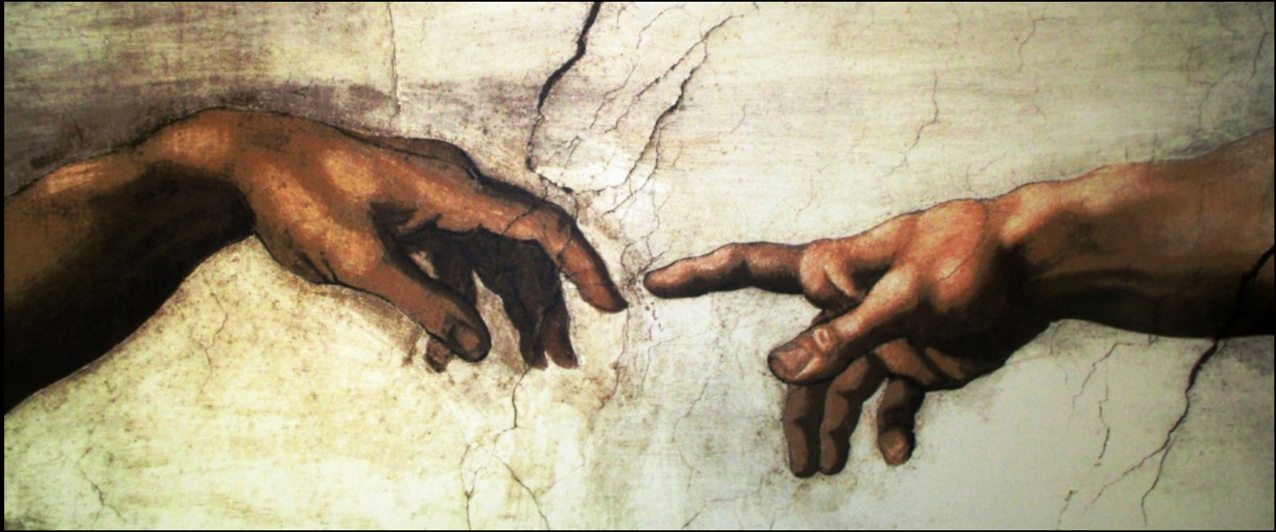
YOU have a Purpose
Notes:
I would like to end with a story that has nothing to do with reconciling, but EVERYTHING to do with your job :) …
In the late 1500s, at age 71, near the end of his career, an engineer & well known artist received his greatest and final commission. He was appointed to be the chief architect on the restoration project of the most well known cathedral in Rome. He obviously looked at this huge project as a very somber and important task because he would be creating a space where people would go to meet, learn, and worship. He wanted the cathedral to be perfect in every detail. He immediately set out looking for assistants that would have the same mindset, approach, and passion for this project as he did.
Work had already been going on at the property for forty years, so the artist went to the construction site to observe the workers there, hoping that he would find some inspired individuals to be his apprentices and assistants. He viewed and interviewed several bricklayers on the site, but was discouraged at their motivations for their work. One bricklayer, when asked what he was doing, just replied, “awweeee, I'm just laying bricks to make money to feed my family”. Another, recognizing the famous painter, wanted the notoriety, pay, and advanced career status that would go with being an assistant under him, but was in it for the wrong reasons..
As he continued around the project, he spotted an older gentleman who was also a bricklayer, mixing his mortar cement on the ground with a hoe. The man worked the cement back and forth, very purposely and steadily and never slowed or even looked up from his task. After watching the man for some time, the artist stepped up beside the man and asked him, “Sir, what are you doing”? The man stopped the hoe in mid-stroke, stood up, and proudly replied with a certain enthusiasm in his voice, “Sir, I am building a cathedral”! It was said, that Michaelangelo hired him as his assistant on the spot.
What are the analogies and applications that we can take away from this wonderful story? Three people were basically doing the same work; one looked at it as merely a job, the second, his career, but the third viewed his job as a calling. The old man saw his job of mixing cement and laying bricks as not just a bricklayer, but as a man called to complete a task. He had a much higher meaning and purpose to his work than did his fellow workers. He was able to see the big picture, even though he was doing a job many would consider mundane and unimportant.
You have a purpose, your job is important, & we want to encourage you to hold your head up high, shoulders back, & be confident in your role. Not cocky, but confident!
Thank you for ALL that you do for UF... for IFAS.... for Extension... & ultimately for your community! <3

