Slide 1
2/8/2024

Slide 2
uf go: Concur tips
Travelers should sign up for e-receipts
Traveler’s name needs to match:
All travel documents (Visa, etc.)
Rewards program information
Name correction needed?
One time change—call World Travel Service (WTS) to change on ticket
Frequent traveler—contact UF Travel team regarding correction
Notes:
What are Representations and Certifications? Reps and Certs are written guarantees made by entities to sponsoring agencies to comply with various requirements.
Only an authorized individual can submit the applicable Reps and Certs.
Federal Government: Can require any additional Reps and Certs per the RFP.
What Reps and Certs apply at the proposal stage?
Federal Government.
The Federal Acquisition Regulations (FAR) System, which established uniform policies for all executive agencies, requires offerors to complete electronic annual representations and certifications in (SAM.gov).
Standard Form 424: Application for Federal Assistance, Field 21: “By signing this application, I certify to the certs and assurances contained in the announcement or agency-specific instructions.”
Common certifications include lobbying, disbarment, civil rights, etc.
Agency Specific Reps and Certs.
Can greatly vary depending on the agency and RFP.
Can include financial information, data rights and intellectual property assertions.

Slide 3
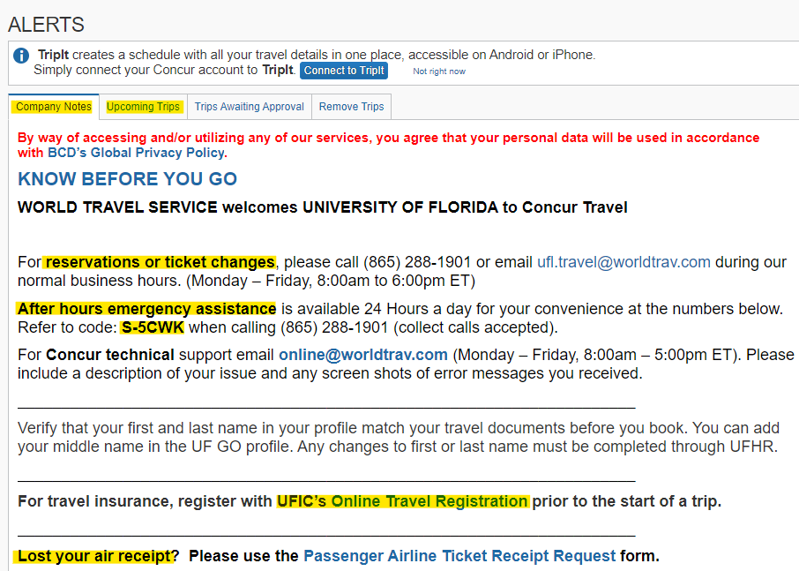
uf go: Concur TRAVEL Home PAGE
Refer to the UF GO Travel home page for:
WTS contact info
Trip library
Registration with UF International Center
Lost airfare receipt
Notes:
The UF GO/Concur Travel home page has a lot of useful information, including:
World Travel Services’ contact information during regular hours and after hours.
Important information regarding your upcoming Trip(s)
International travelers must register with UF’s International Center before each trip. There is a link to that registration website, on the Concur homepage.
It’s very easy to get a copy of your airline receipt if you can’t find it. Just click the link here and with a little bit of information, you will be able to get a copy of the receipt.
Note: If WTS tells you there is a fee to use WTS, there is, but UF’s Controller’s office is paying that fee, so don’t let that stop you from using the Booking Tool. The Booking Tool is mandatory when UF funds are used, regardless of the payment method being used at booking.

Slide 4
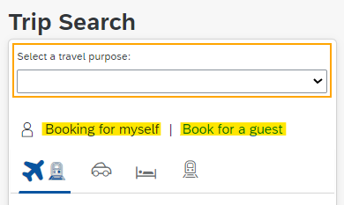
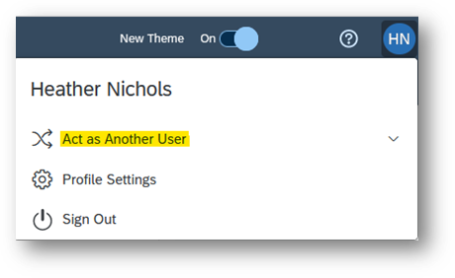
uf go: Whose profile to use?
Booking for (Payment Method) | Profile to Use
Yourself or a Profiled user (with your PCard) | Your profile
A guest (with your PCard or the Aircard) | Your profile and click ‘Book for a guest’
A profiled user (with their PCard, the Aircard, or a personal card) | ‘Act as’ the traveler, click ‘Booking for myself’ under their profile
Notes:
Before booking travel for someone else, consider what payment method(s) you will be using. This will help you decide whose profile you should use when booking travel.

Slide 5
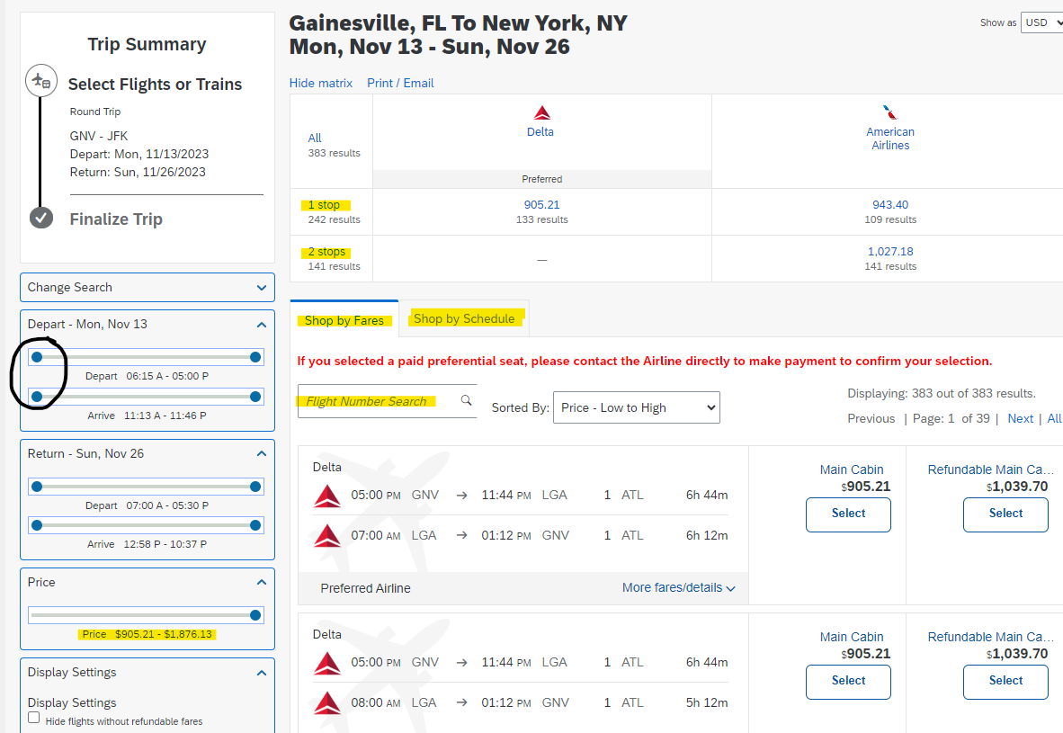
uf go: airfare SEARCH
Search Options:
By fare
By schedule
By a specific flight number
By number of stops
Depart and Arrive times
Adjust sliding bars on the righthand side
*Click on More fares/details
Notes:
There are multiple ways to Search for flights in UF GO:
Shop by fare
Shop by Schedule
Search for a SPECIFIC FLIGHT NUMBER
Number of stops
Depart and Arrive times
Adjust the sliding bars on the righthand side.

Slide 6
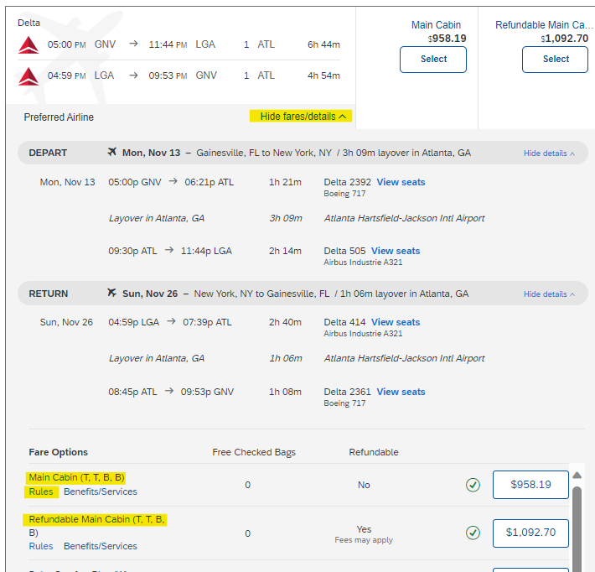
uf go: airfare SEARCH
Clicking on More fares/details gives you more information regarding all the cabin types available.
*Make sure to click on Rules
Notes:
More fares/details will give you all the flight cabin options.
Make sure to click on Rules to learn about cancellation penalties. See next slide.

Slide 7
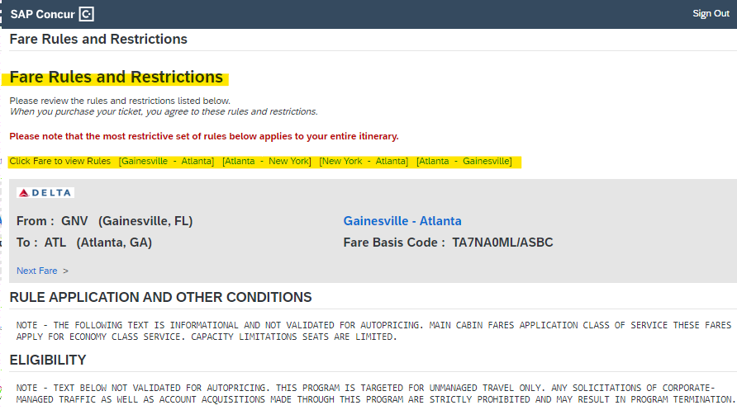
uf go: airfare SEARCH
Read the Fare Rules and Restrictions carefully!
Pay close attention to the PENALTIES section!
Notes:
The Fare Rules and Restrictions will give you lots of information regarding the flight.
These rules may be different for different flights/airlines, so make sure to review these for each trip.
This will give you information as to the refundability of the flight and other penalties.
General rule of thumb:
CANCELLING AIRFARE: Free cancellation for 24 hrs. After 24 hrs., fees and penalties are determined by the type of airfare booked and the Airline’s policies.

Slide 8
uf go: Hotel rates & discounts
AAA/CAA, Government, or Military | Under Travel Preferences in traveler's profile, check the box for the discount (must provide documentation to hotel)
UF Rate | UF negotiated rate
BCD | World Travel Services discount for ALL UF travelers
Member Rate | Must be a member of the Loyalty program for the hotel chain (Marriott Bonvoy, Hilton Honors)
Regular Rate | Available to everyone
Notes:
There are several hotel rates listed in Concur. It is important to make sure the traveler qualifies for the rate before you choose that rate as they will be required to provide verification of their eligibility upon arriving at the hotel.
Here is a summary of the rates:
AAA/CAA, Government, or Military -
Under Travel Preferences in traveler's profile, check the box for the discount (must provide documentation to hotel)
UF Rate - UF negotiated rate
BCD - World Travel Services discount for ALL UF travelers
Member Rate - Must be a member of the Loyalty program for the hotel chain (i.e. Marriott Bonvoy, Hilton Honors)
Regular Rate - Available to everyone

Slide 9
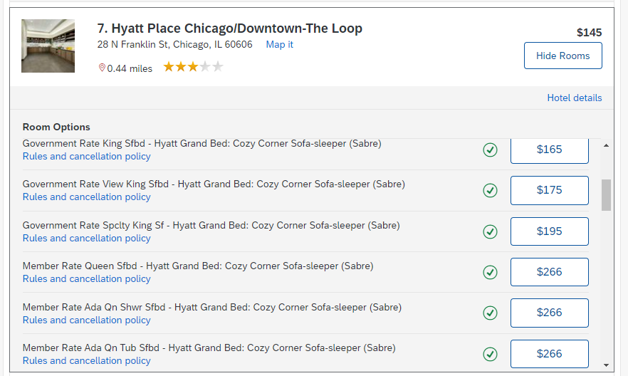
uf go: Hotel rates & discounts
Notes:
There are several hotel rates listed in Concur. It is important to make sure the traveler qualifies for the rate before you choose that rate as they will be required to provide verification of their eligibility upon arriving at the hotel.
Here is a summary of the rates:
AAA/CAA, Government, or Military -
Under Travel Preferences in traveler's profile, check the box for the discount (must provide documentation to hotel)
UF Rate - UF negotiated rate
BCD - World Travel Services discount for ALL UF travelers
Member Rate - Must be a member of the Loyalty program for the hotel chain (i.e. Marriott Bonvoy, Hilton Honors)
Regular Rate - Available to everyone
Please review the Rules and cancellation policy here as well.

Slide 10
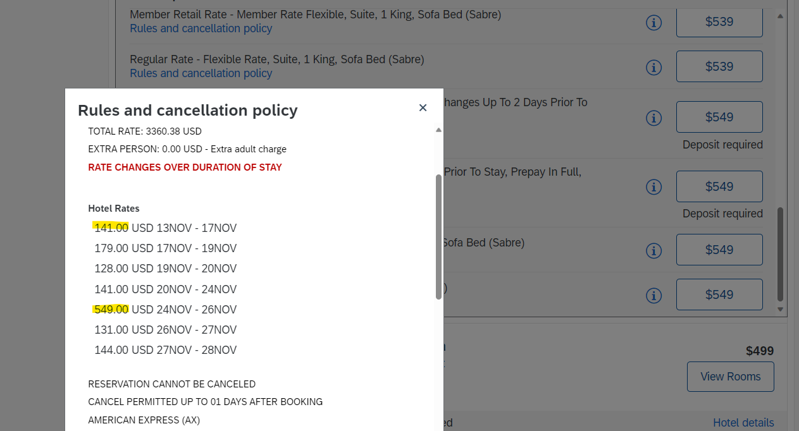
uf go: Hotel rates & discounts
Notes:
Clicking on the Rules and cancellation policy will show you the nightly rates for the days you selected. The rate listed on the initial search usually gives the highest rate over the stay. As you can see here, the nights vary significantly. From $141 to $549 per night. Please make sure to check these rates and include these rates in your cost comparisons.

Slide 11
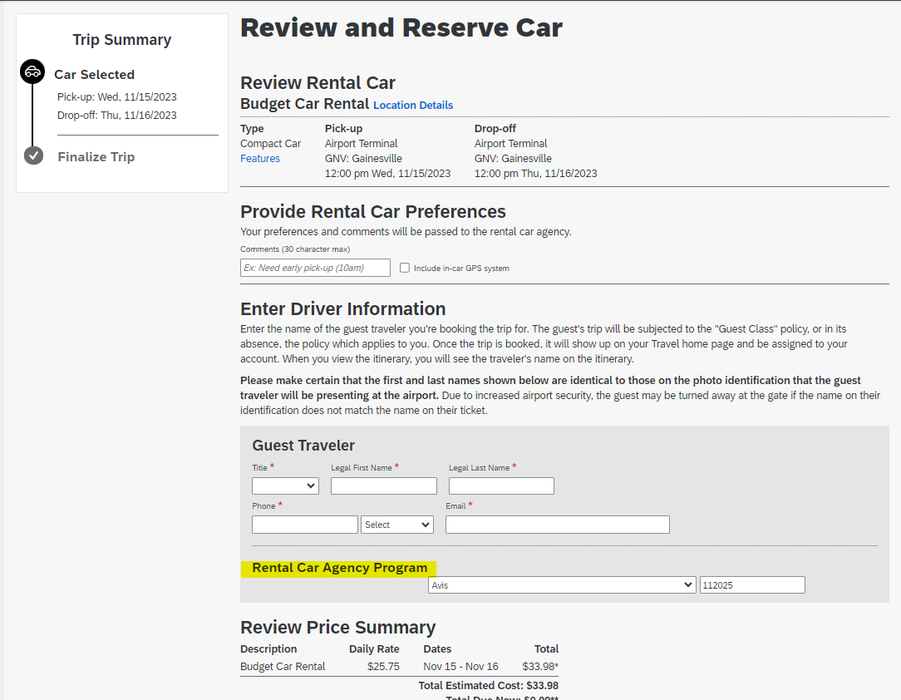
uf go: Car rental / reservations
Avis: Direct Billing Number vs Wizard number
Direct Billing number—tied to P-Card
Wizard number--loyalty number tied to a person
Direct Billing Number
Both Direct Billing number and Wizard number are alpha numeric and are the same number of digits in length. Call Avis to confirm if you’re not sure which you have.
Notes:
Avis: Direct Billing Number vs Wizard number
Direct Billing number--tied to the payment method i.e. PCard.
Complete form & return to Avis
If booking for employee or Guest using your PCard connected to Global Billing number—use Book for a Guest
Wizard number--loyalty number tied to a person
If using Wizard number to reserve a car, it will only reserve the car--traveler must pay for the car at pick up
Avis verifies UF employee or guest traveler information using UFID or letter from dept.

Slide 12
uf go: Finalizing your trip
Finalize your trip—make sure trip is ticketed!
Booking is not complete until you see the word FINISHED!
Even if only booking car or hotel, must get to FINISHED! page
Reminder: If you cancel any part of your trip, it will cancel ALL of it!
Notes:
Be sure to finalize your trip—make sure trip is ticketed!
Booking is not complete until you see the word FINISHED! at the top of the completed reservation page
Even if your only booking a car or hotel, you must get to FINISHED! page
Once you see FINISHED! you can sign out or return to the Home Page
Reminder: If you cancel any part of your trip, it will cancel ALL of it!

Slide 13
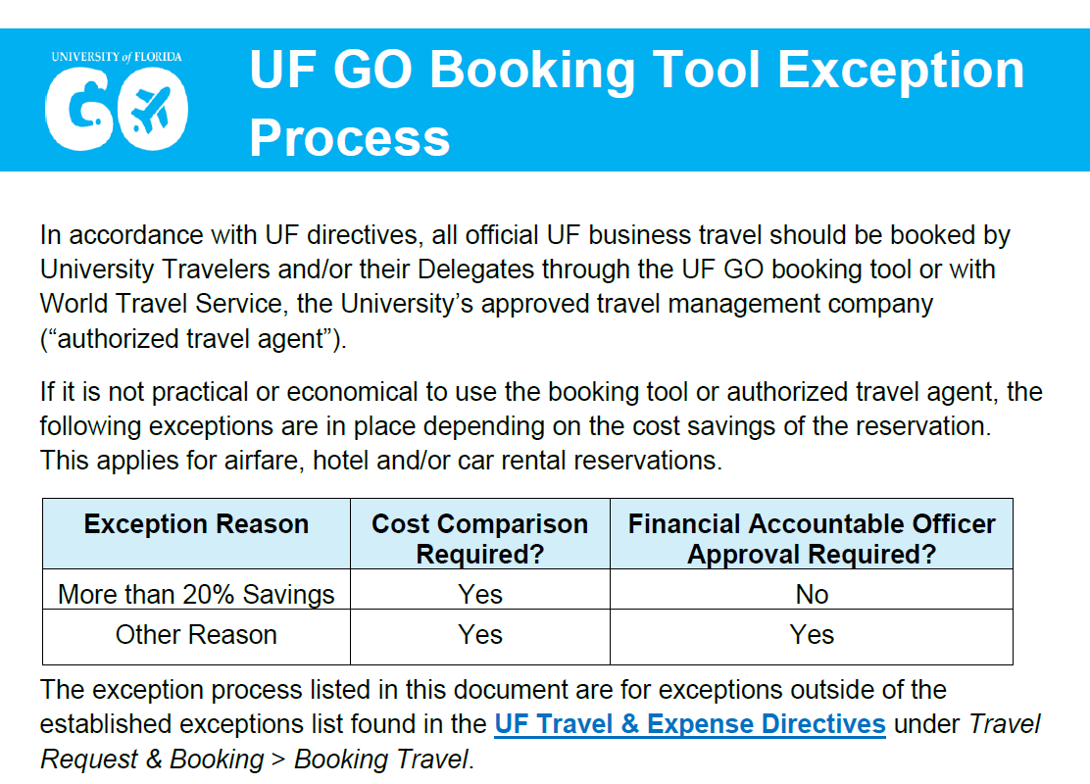
UF go: exceptions to booking tool
In addition to established exceptions
Help with price differences
Provide a path forward on other reasons outside of traveler’s control
Not due to preference
Not due to personal reasons
Include cost comparison for all exceptions
Notes:
Be sure to finalize your trip—make sure trip is ticketed!
Booking is not complete until you see the word FINISHED! at the top of the completed reservation page
Even if your only booking a car or hotel, you must get to FINISHED! page
Once you see FINISHED! you can sign out or return to the Home Page
Reminder: If you cancel any part of your trip, it will cancel ALL of it!

Slide 14
UF go: cost comparisons
Are typically created at the same time the fight is being booked
Required for booking tool exceptions and trips that include personal travel.
Must be created in the UF GO Booking Tool
Travel Expense | Requirements
Airfare with Personal Travel | Cost Comparison should be created for the business travel days only If not created at time of booking, will have to be created after the fact
Hotel vs. rental properties (AirBnB, Vrbo) | Cost Comparison should be based on a reasonable hotel closest to the event or business
Notes:
Be sure to finalize your trip—make sure trip is ticketed!
Booking is not complete until you see the word FINISHED! at the top of the completed reservation page
Even if your only booking a car or hotel, you must get to FINISHED! page
Once you see FINISHED! you can sign out or return to the Home Page
Reminder: If you cancel any part of your trip, it will cancel ALL of it!

Slide 15
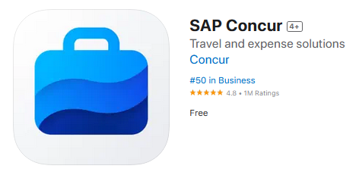
uf go: FINAL THOUGHTS
Mobile apps for travelers:
SAP/ Concur
TripIt
Notes:
Provide a cost comparison with your travel report if your trip includes personal travel.
Tip: Complete the cost comparison at the same time you are booking your flight!

Slide 16
uf go: CONTACT INFORMATION
World travel services
Reservations or ticket changes: (865) 288-1901
(M-F, 8:00am to 6:00pm ET) ufl.travel@worldtrav.com
After hours emergency assistance: (865) 288-1901
(24 hours/day, collect calls accepted) Refer to code: S-5CWK
when calling
Concur technical support email: online@worldtrav.com
(M-F, 8:00am – 5:00pm ET) Include description of the issue & screenshot(s) of error messages

Slide 17
uf go: CONTACT INFORMATION
UF travel department
For questions or assistance:
UF Travel Department: 352-392-1241
Contact Form: https://uf.tfaforms.net/f/Finance-Hub
Toolkits for booking travel: Travel – Learn & Grow (ufl.edu)
We are happy to help!

